Slide 1
STRATHMORE LECTURE ROOM RESOURCE MANAGEMENT SYSTEM
NJAKAI DAVID SERONEY
BBIT 4B
71392

Slide 2
About:
A system that provides a platform to be used by Strathmore Students, Lecturers and faculty administrators for effective and convenient utilization of the campus’ lecture rooms.
Students: Viewing of vacant rooms
Lecturers: Reservation of rooms
Administrator: Adding and authorizing users

Slide 3
Problem Statement:
Students usually waste a lot of valuable time searching for vacant rooms during their intervals between classes
Lecturers are forced to go through unnecessarily stringent procedures when in need of booking a room or when requesting for a change in venue
Conflict usually arises when there is contention for use of a room for two different classes
Course unit completion is virtually unrecognized in relation to the increase in available resource(lecture rooms) brought about
All these issues lead to cumulative wastage of time that could otherwise be used more productively as well as leading to uneconomic use of resources.

Slide 4
Objectives
To create a system that allows a student to have on-the-go notifications on availability of rooms at a desired time range
To give lecturers a platform to directly reserve a vacant room
To notify users of reservations made on certain lecture rooms to avoid conflict of events
To develop functionality that allows lecturers to ‘release’ rooms upon completion of a course in a given semester thus increasing the pool of reservable and utilizable resources
All these functions will be available from the convenience of one’s mobile phone!

Slide 5
Methodology
Object Oriented Program
Java
Android
Remote Database Service (MySQL)

Slide 6
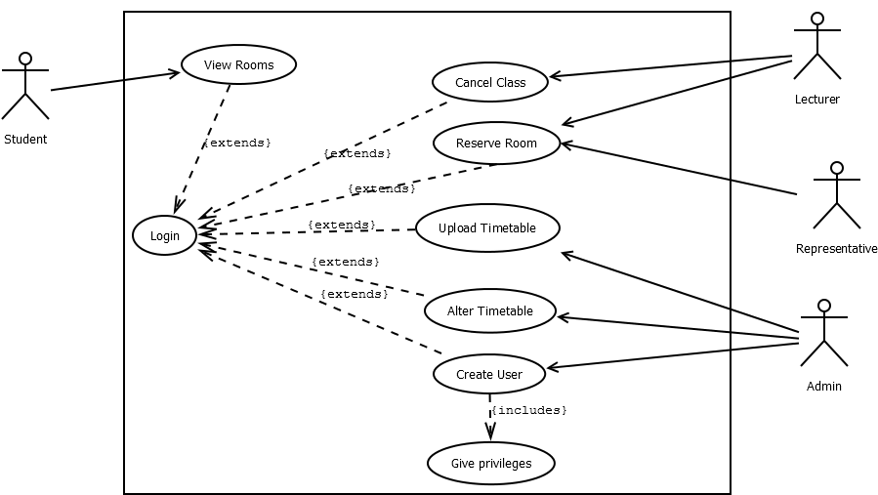
Use Case Diagram

Slide 7
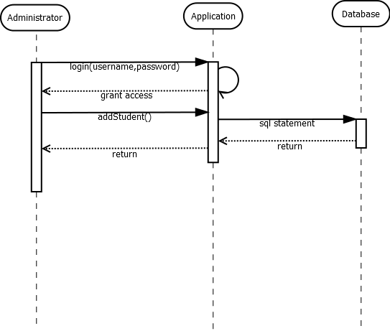
Sequence Diagrams

Slide 8
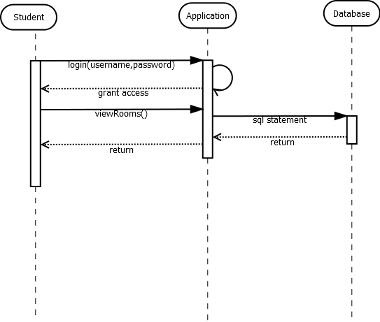

Slide 9


Slide 10
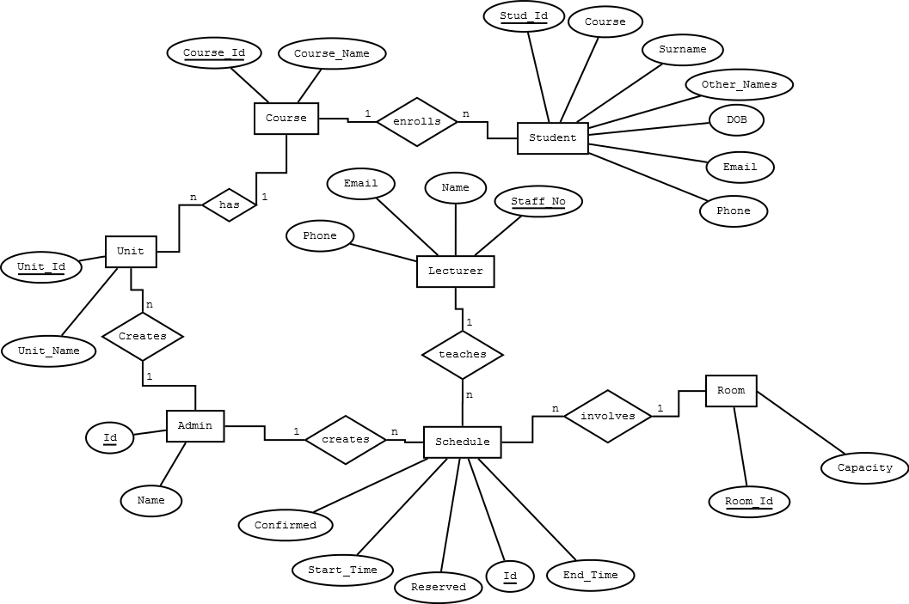
Entity Relationship Diagram

Slide 11
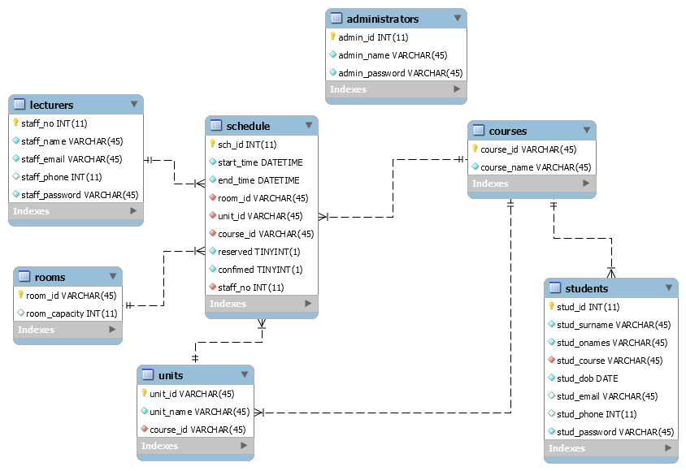
Database Schema

Slide 12
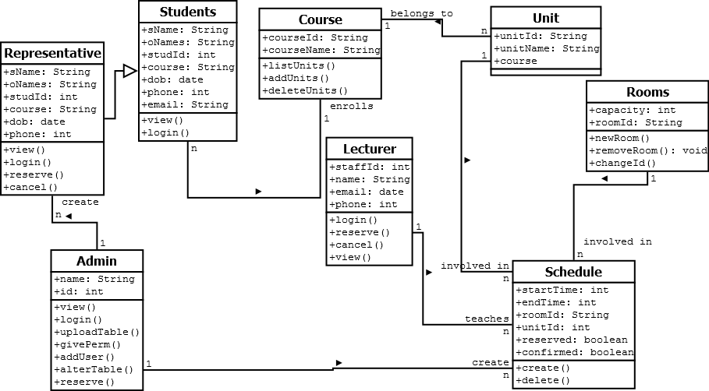
Class Diagram

Slide 13
THANK YOU!

